Slide 1
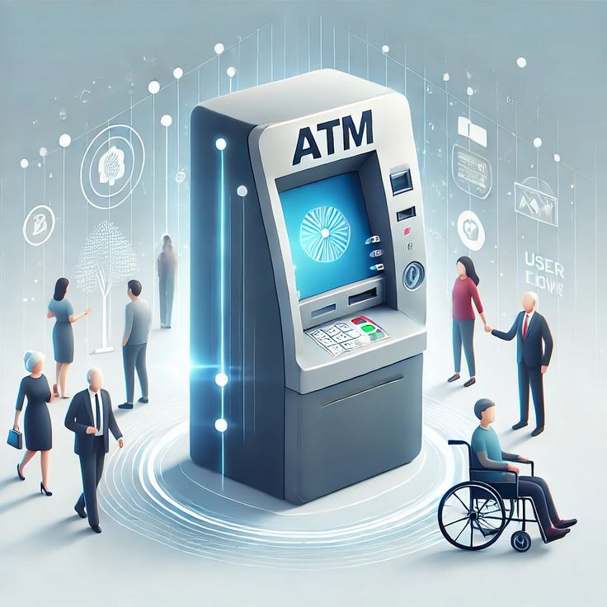
AUTOMATED TELLER MACHINE(ATM)
PRESENTED BY:
JAHNAVI(25A31A05BW)
VANDANA(25A31A05CA)
TEJASWINI(25A3105CL)
SIVA(25A3105DE)

Slide 2
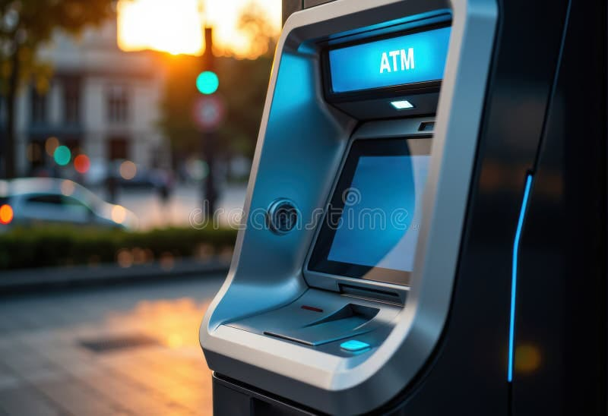
Content
Abstract
2. Introduction
3. Applications
4. Existing Methodology
5. Drawbacks of Existing System
6. Proposed Methodology
7. Advantages of Proposed Method
8. Architecture
9. Results / Screenshots
10. Conclusion
11. Queries

Slide 3
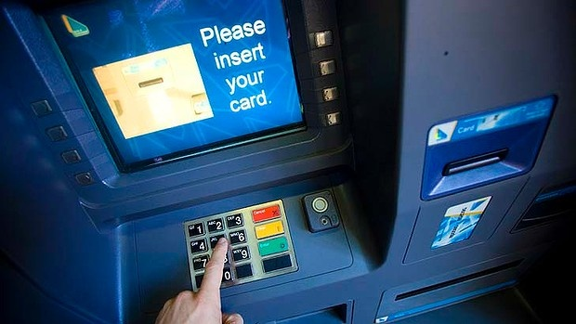
Abstract (ATM Machine Project)
An Automated Teller Machine (ATM) is a self-service banking device that allows users to withdraw cash, check balance, and perform basic transactions using a debit card and PIN. This project explains how an ATM works, its components, transaction flow, and how it improves banking convenience by providing fast and secure services 24×7.

Slide 4
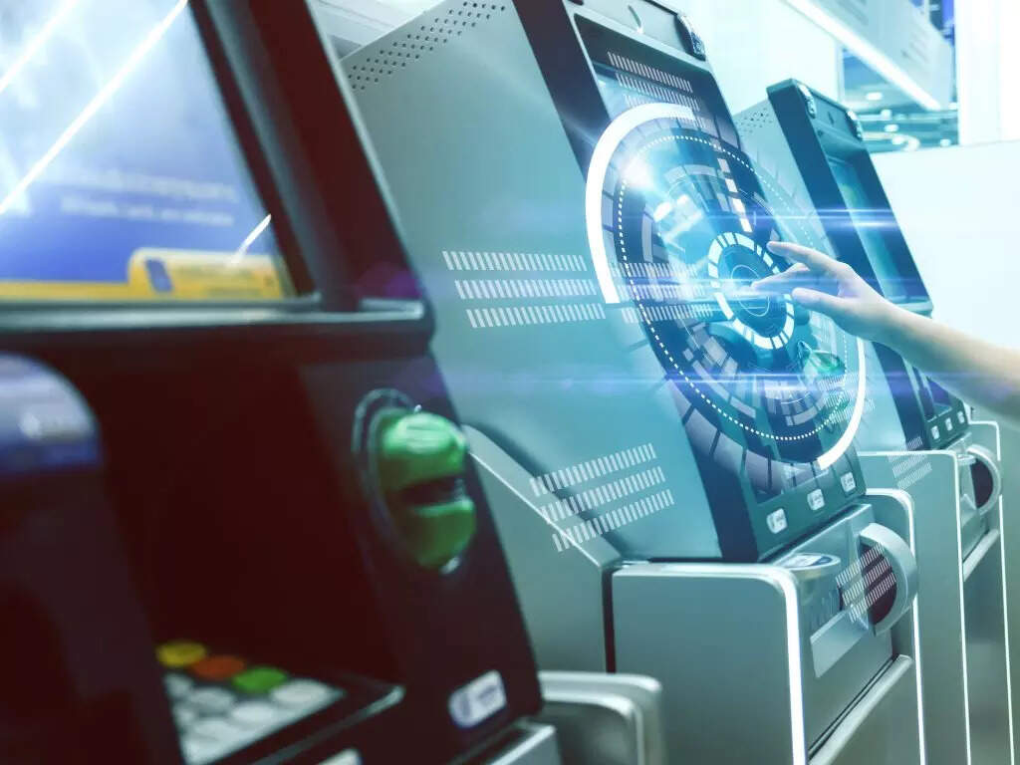
INTRODUCTION OF ATM MACHINE
WHAT IS ATM MACHINE?
ATM stands for Automated Teller Machine
Electronic device used for cash withdrawal
Allows basic banking services without a bank staff Provides quick, easy, and
24/7 access to money Found in banks, malls, and public places

Slide 5
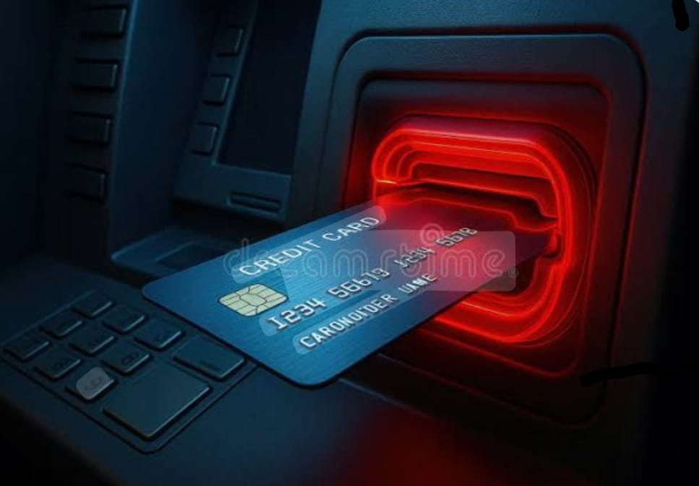
Applications
Cash withdrawal
Balance enquiry
Mini statement
PIN change service
Fund transfers
Cash deposit (in deposit ATMs)
Provides banking access in remote locations

Slide 6
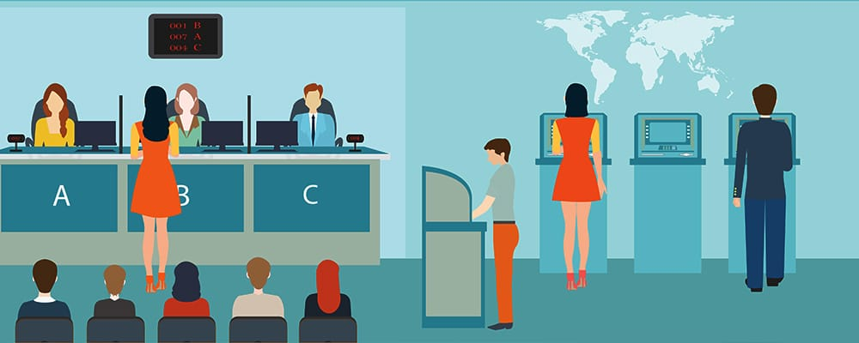
Existing Methodology
Before ATMs, customers needed to:
Visit the bank branch physically
Fill withdrawal or deposit forms
Wait in long queues
Depend on working hours of the bank
Use passbooks for balance checking
This manual system was slow, time-consuming, and required more human effort.

Slide 7
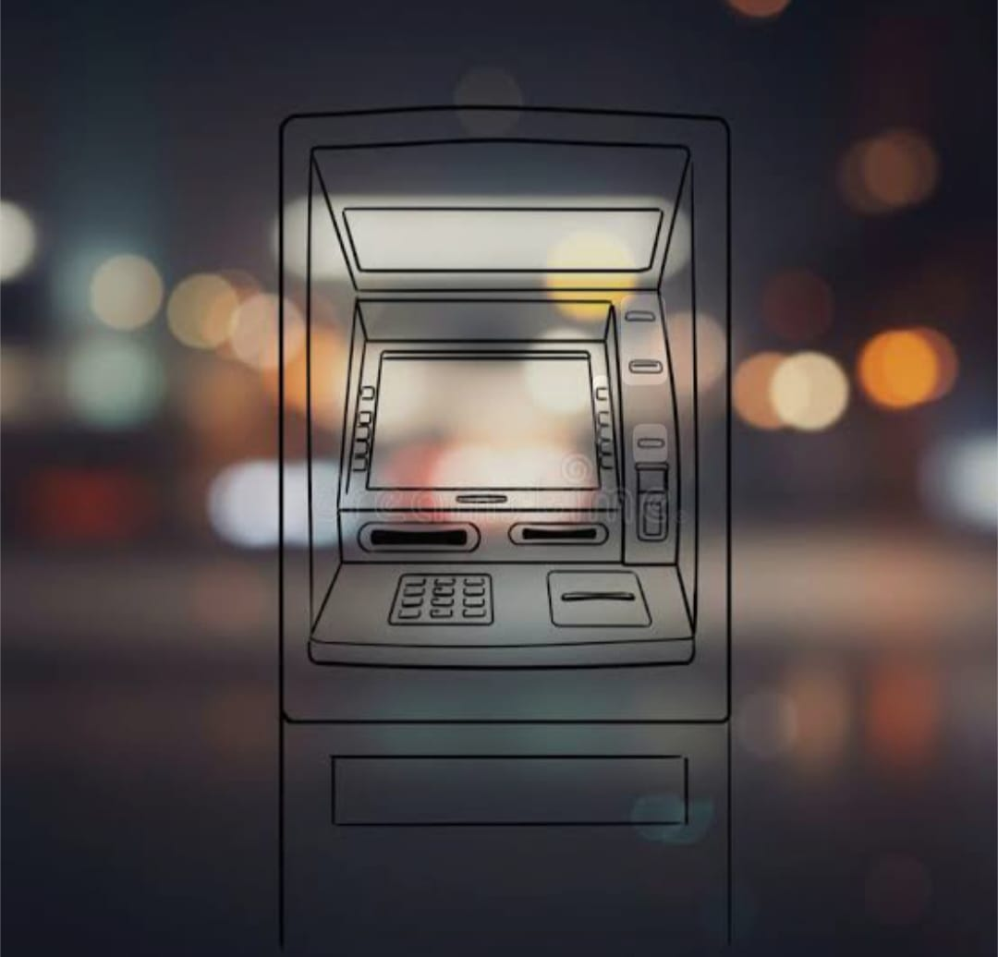
Drawbacks of Existing Methodology
Limited to bank working hours
  More manual paperwork
Long queues and waiting time
  High dependency on bank staff
No access to instant cash
  Slow and inconvenient for users
  Drawbacks of Existing Methodology
  Limited to bank working hours
  More manual paperwork
  Long queues and waiting time
  High dependency on bank staff
  No access to instant cash
  Slow and inconvenient for users Option

Slide 8
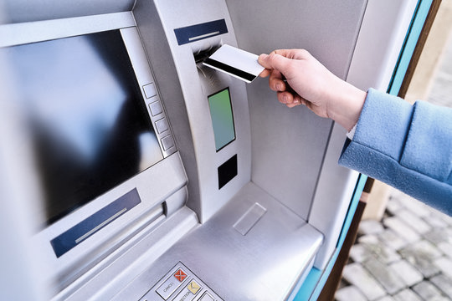
Proposed Methodology
User inserts the ATM card.
System reads card details.
3. User enters the PIN.
PIN is verified with the bank server.
User selects a transaction (withdrawal, balance enquiry, etc.).
System processes the request and updates the account.
Result is shown on the screen or printed as a receipt.

Slide 9

ADVANTAGES OF THE PROPOSED METHODOLOGY:
24×7 banking serviceFast and convenient transactions
2. Reduces manual work in banks
3. Less waiting time for users
4. Secure and reliable system
5. Accessible even in remote areas

Slide 10
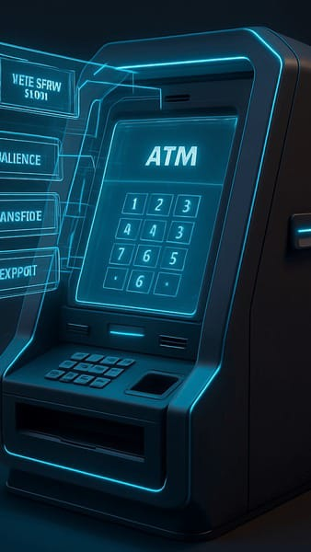
Architecture of proposed methodology
Input Devices: Card reader, keypad, touch screen
Processing Unit: ATM controller/computer
Output Devices: Display screen, receipt printer, speaker
Cash Mechanism: Cash dispenser, cash deposit slot
Secure Network: Connects to bank server via encrypted network

Slide 11
RESULT (ATM Machine Output)
ATM Receipt – Sample Output
Bank Name: SBI Bank
ATM ID: ATM1023
Date: 03-12-2025
Time: 10:42 AM
Card Holder Name:Vandana
Account Number: XXXX 4523
Transaction Type: Cash Withdrawal
Amount Withdrawn: ₹2,000
Available Balance: ₹18,450
Transaction Status: SUCCESS
Reference No: 7845129630
Thank you for using SBI ATM!

Slide 12
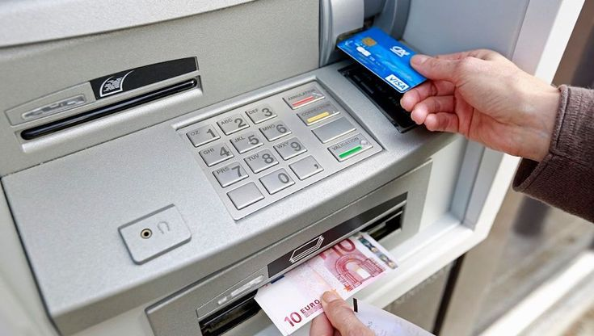
CONCLUSION
Provides 24/7 access to banking services
Enables cash withdrawal, balance inquiry, and fund transfers .
Ensures security through PIN authentication.
Saves time and reduces the need to visit banks.
Makes banking faster, easier, and user-friendly.

Slide 13

Any Queries:
Thank You!
.

